Slide 1
UCSD Embedded C Assignment 7
By
Hsuankai Chang
hsuankac@umich.edu

Slide 2
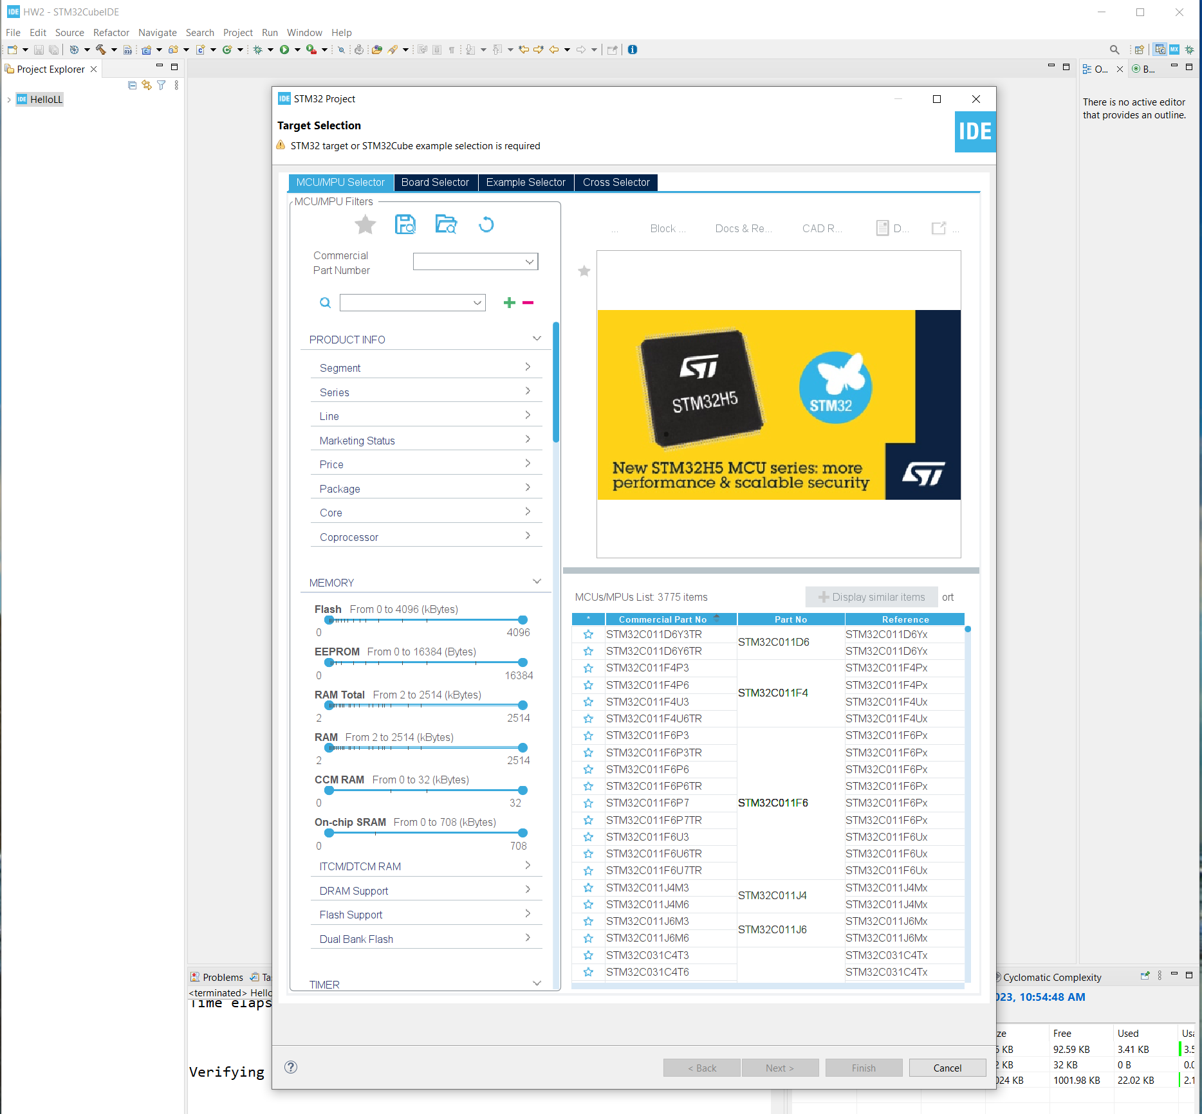
Step 1. Startup STM32CubeIDE and create new STM32 project

Slide 3
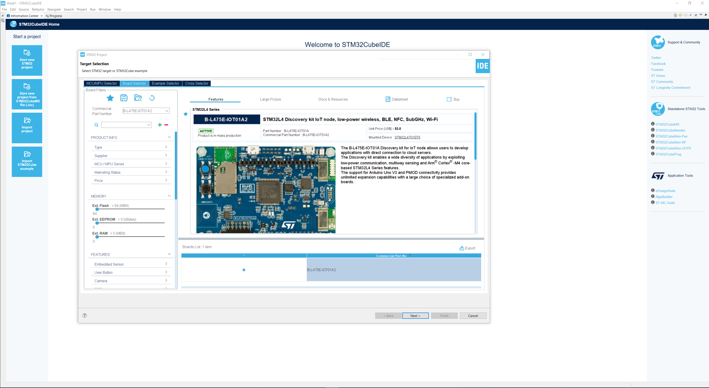
Step 2. Access board selector and type in the board you use, click Next

Slide 4
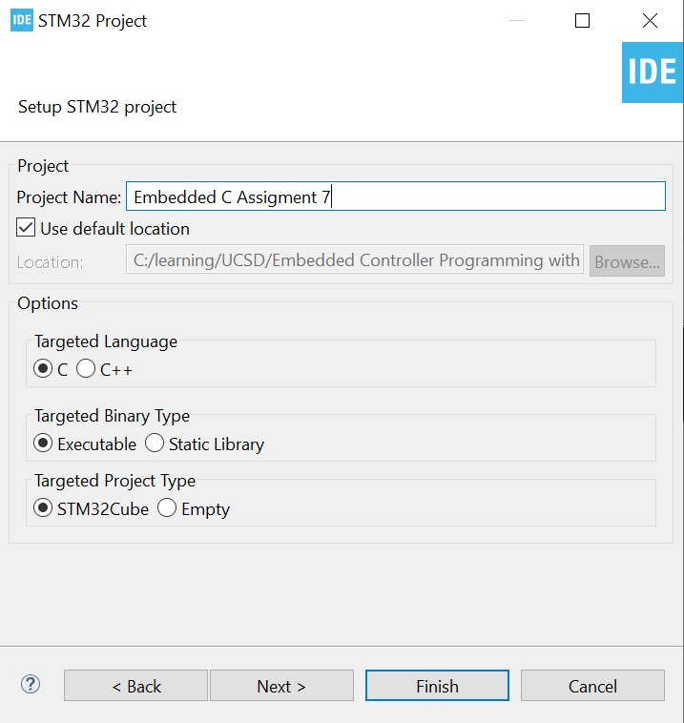
Step 3. Enter the project name then click Next

Slide 5
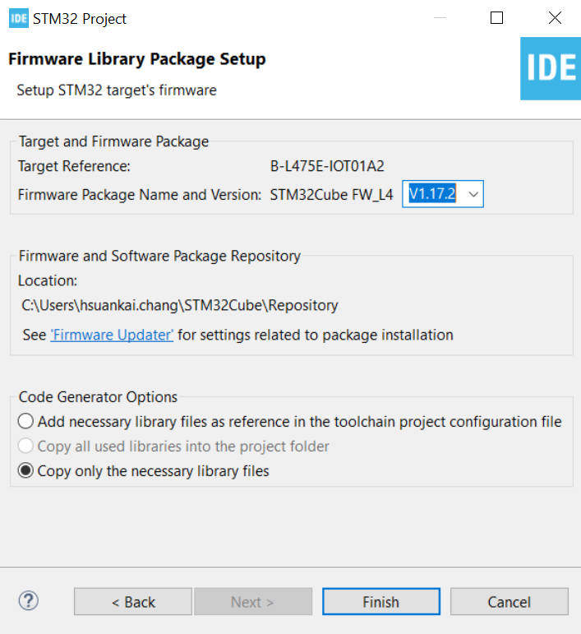
Step 4. See the firmware package name and version

Slide 6
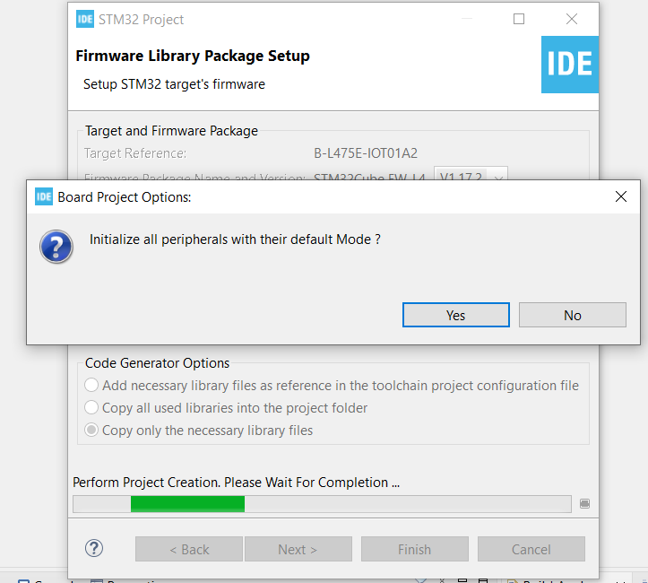
Step 5. Click yes to initialize all peripherals to default

Slide 7
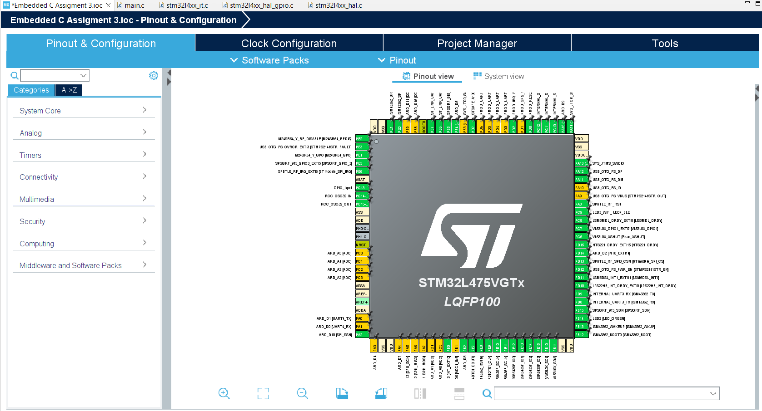
Step 6. When in .ioc file, click Pinout & Configurations

Slide 8
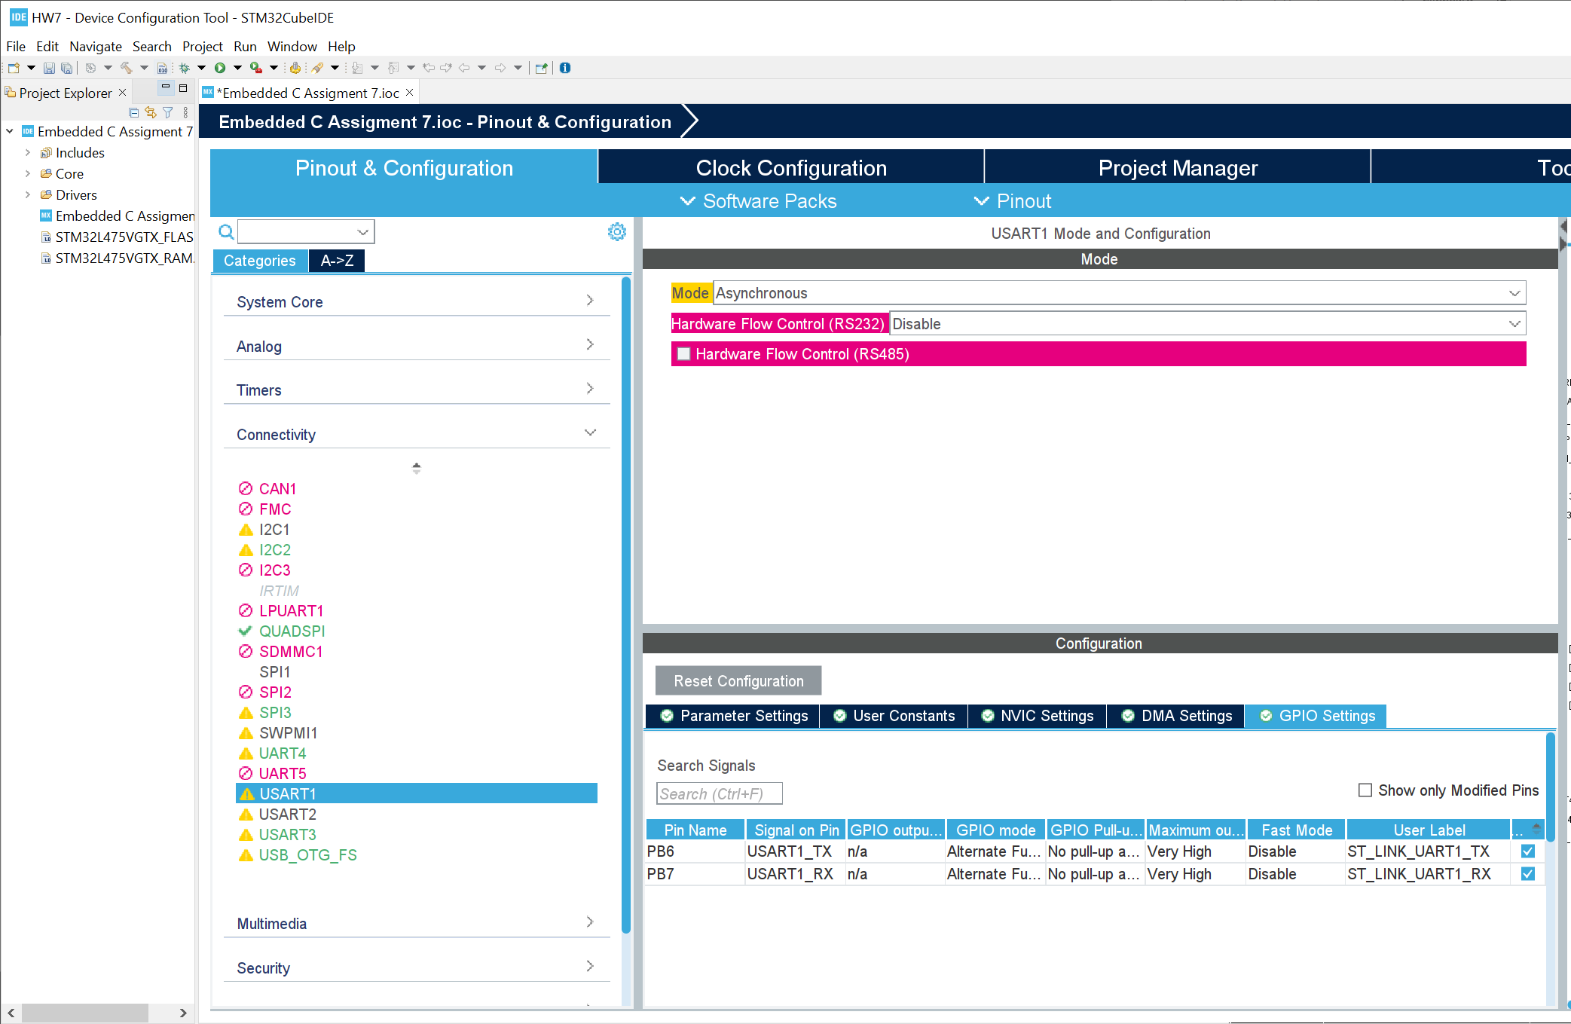
Step 7. Check the setting for USART1

Slide 9
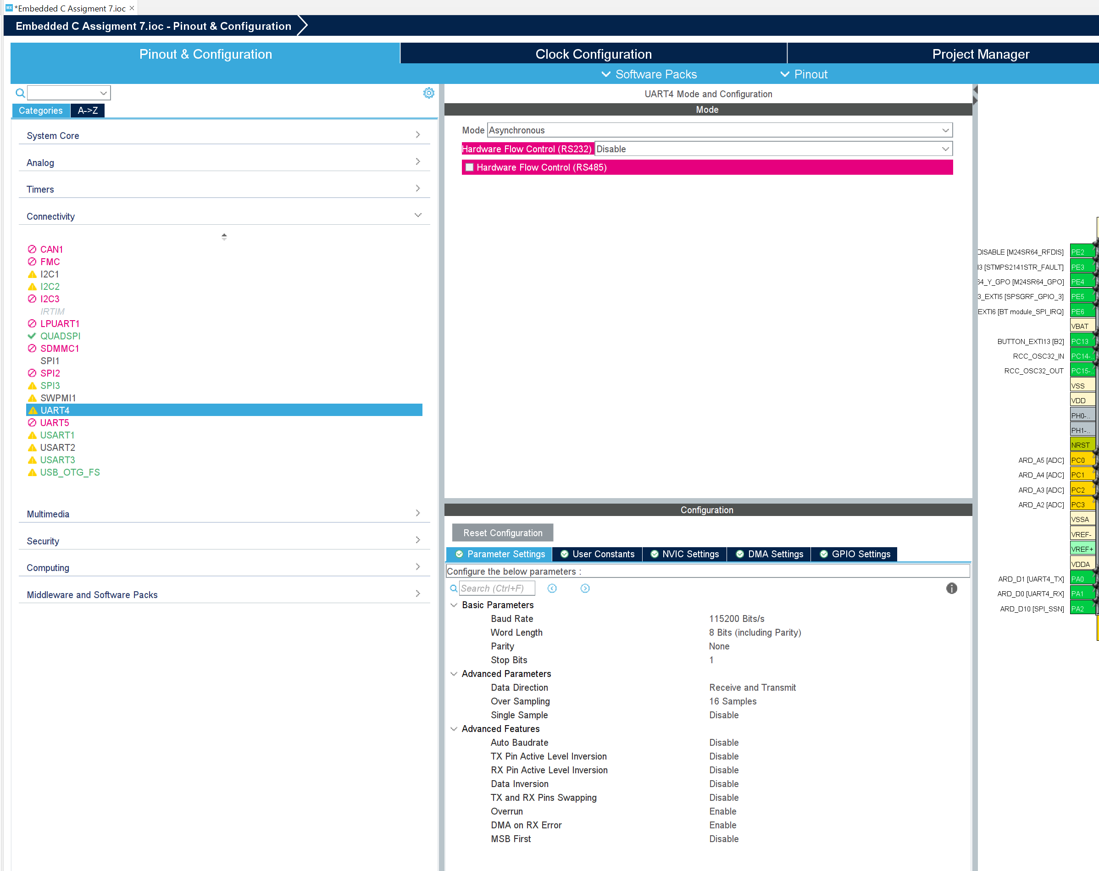
Step 8. Enable UART4 connection

Slide 10
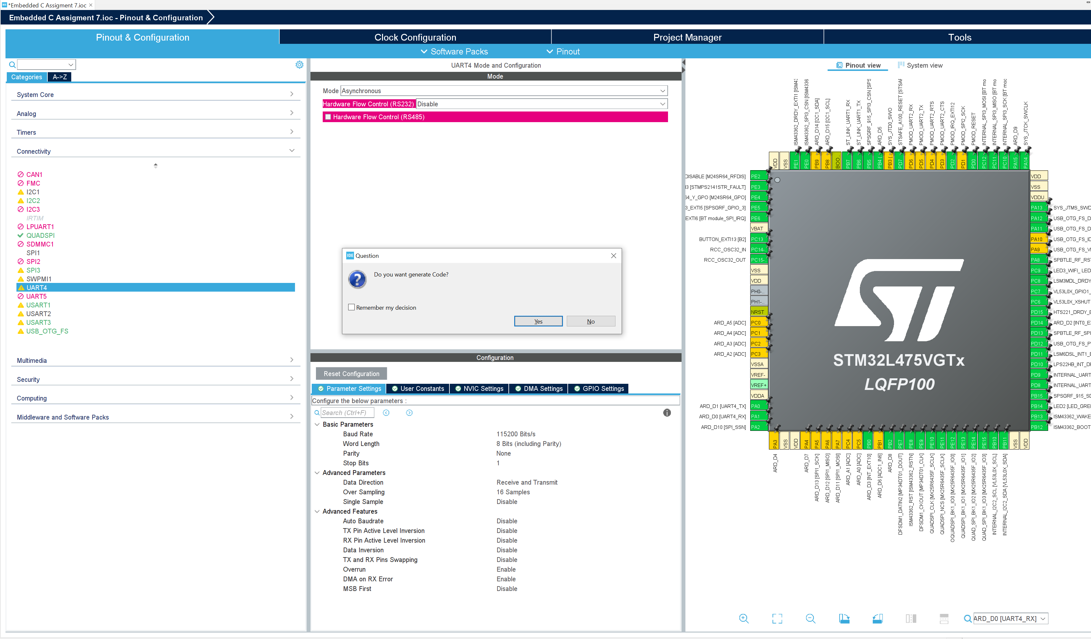
Step 9. Generate code

Slide 11
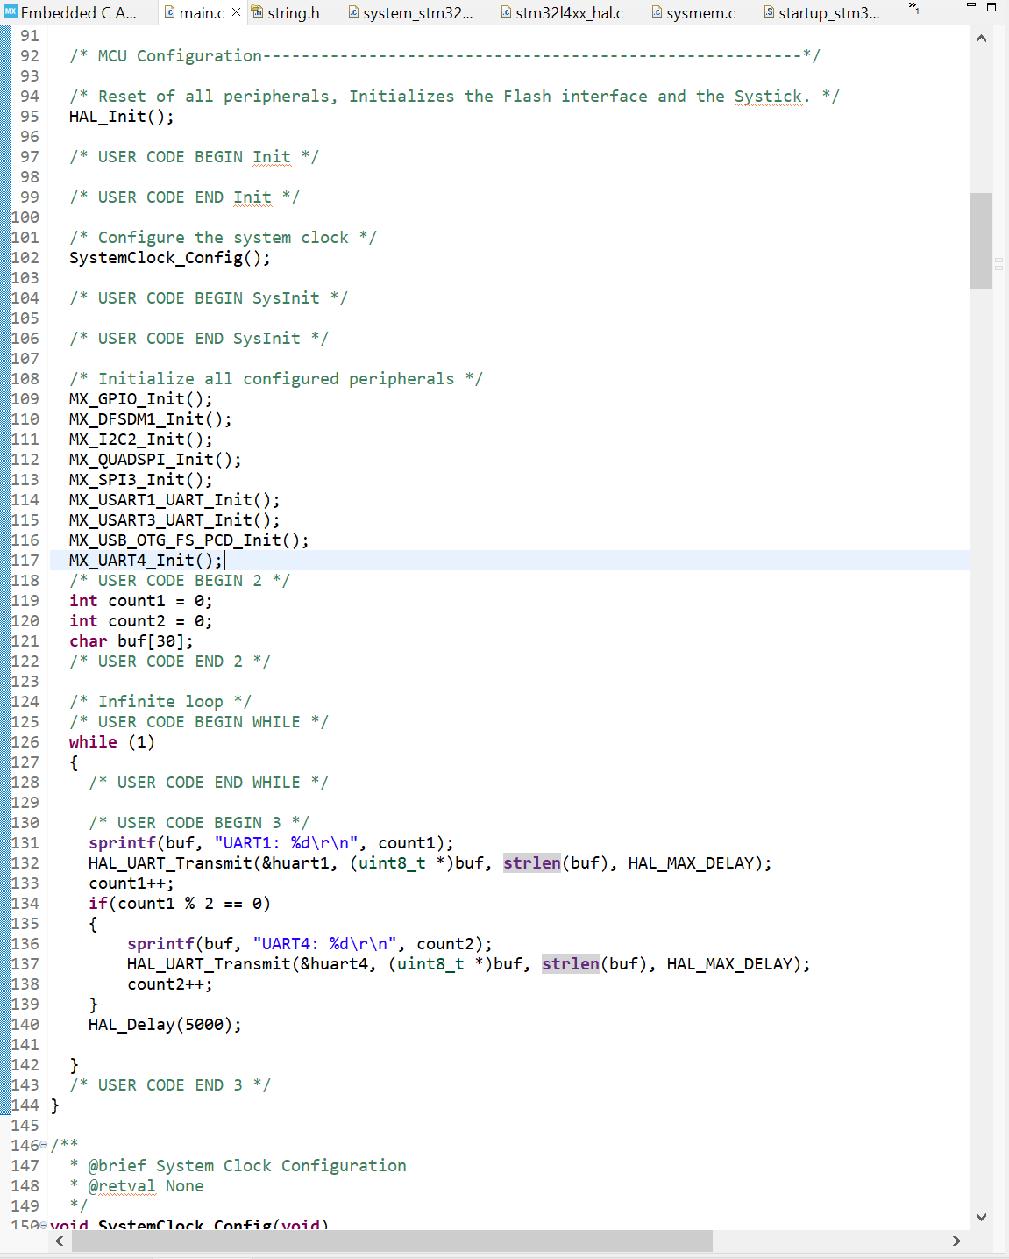
Step 10. In main.c, type the code below to send message to UART1 every 5 second, and to UART4 every 10 seconds

Slide 12
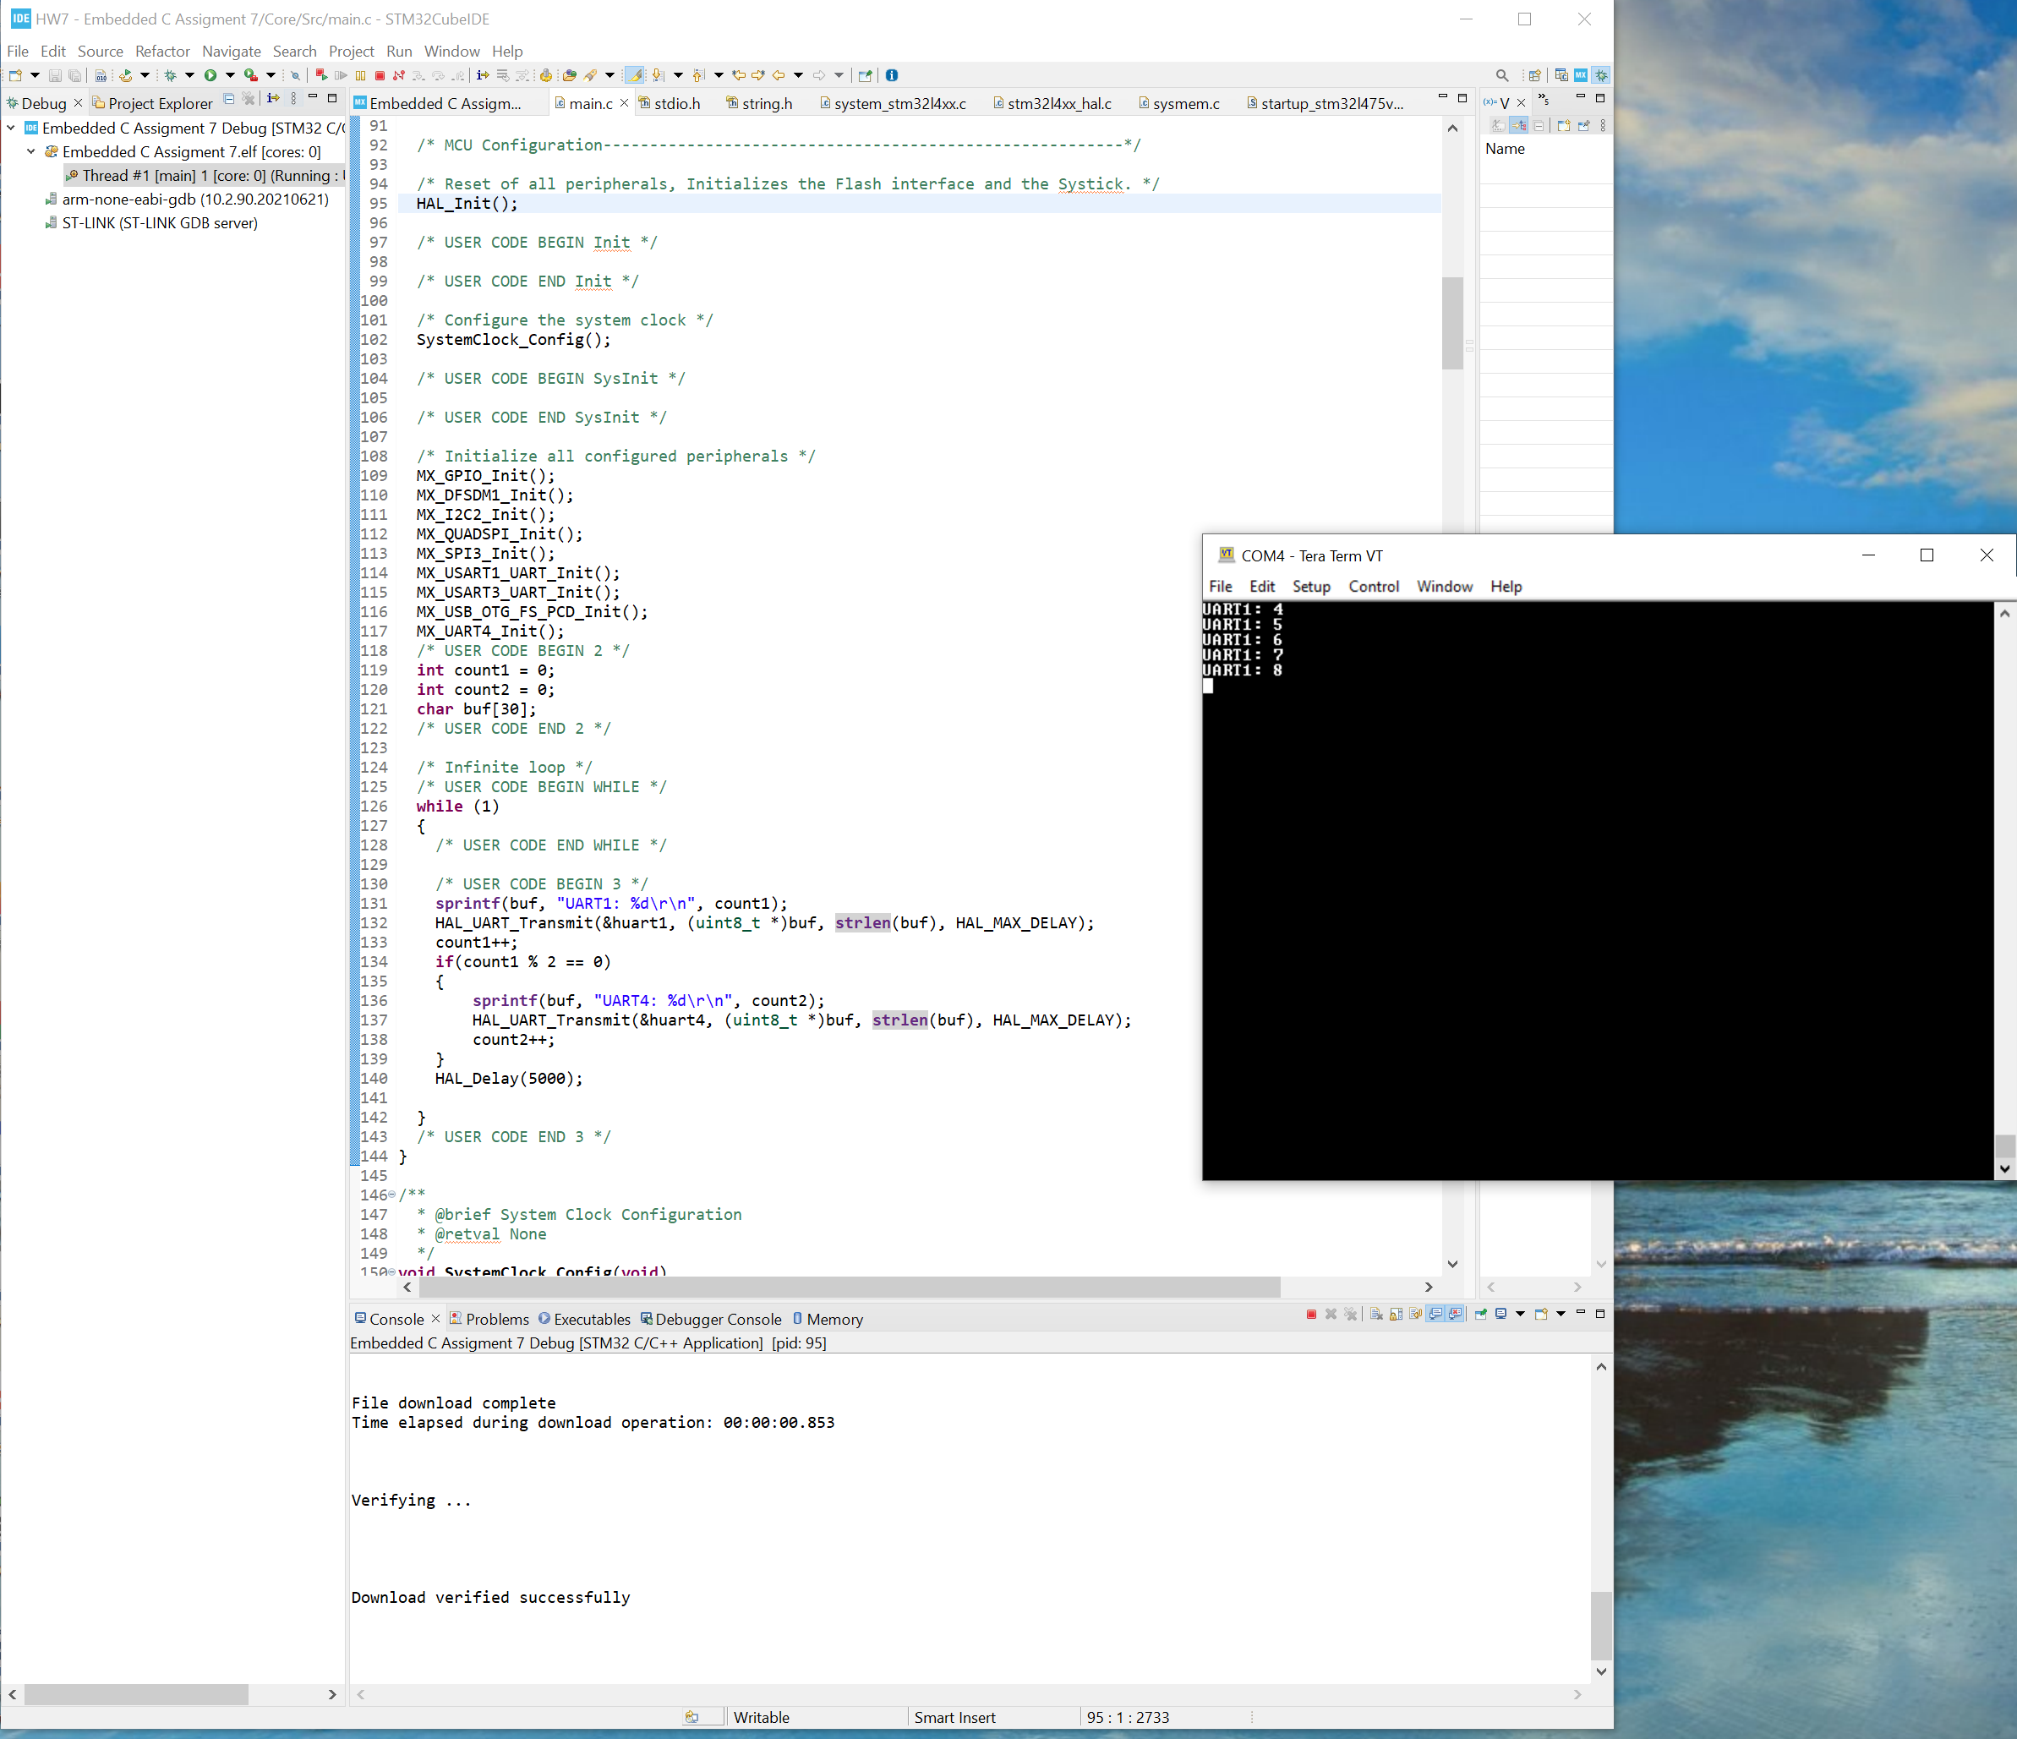
Step 11. Build the code, run in debug mode and open Tera Term to see if we can see the UART1 message

Slide 13
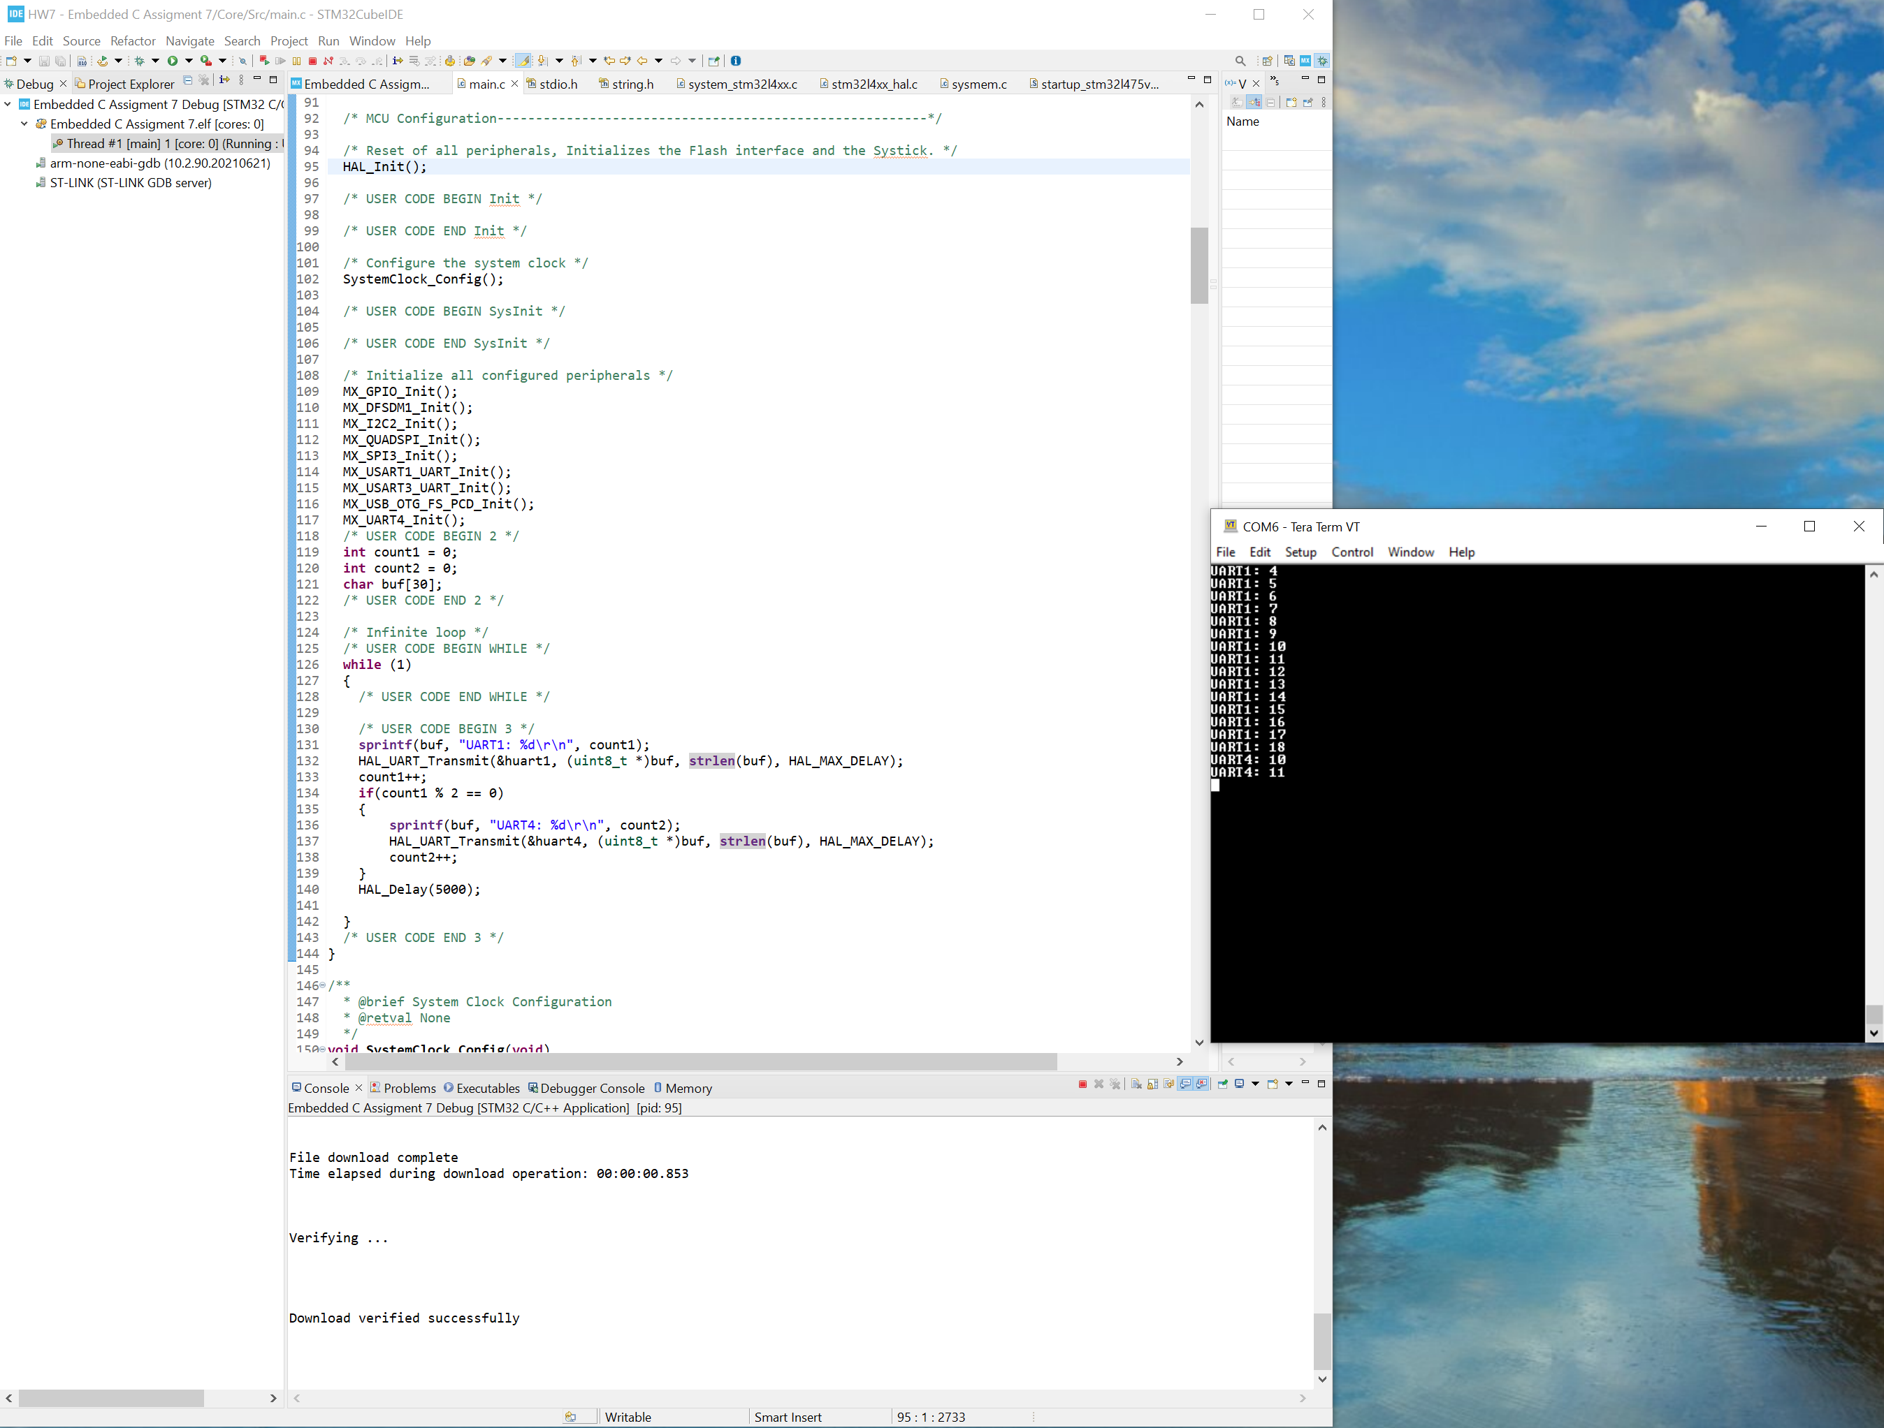
Step 12. Switch Teram Term serial port to see if we can UART4 message, test is successful

Slide 14
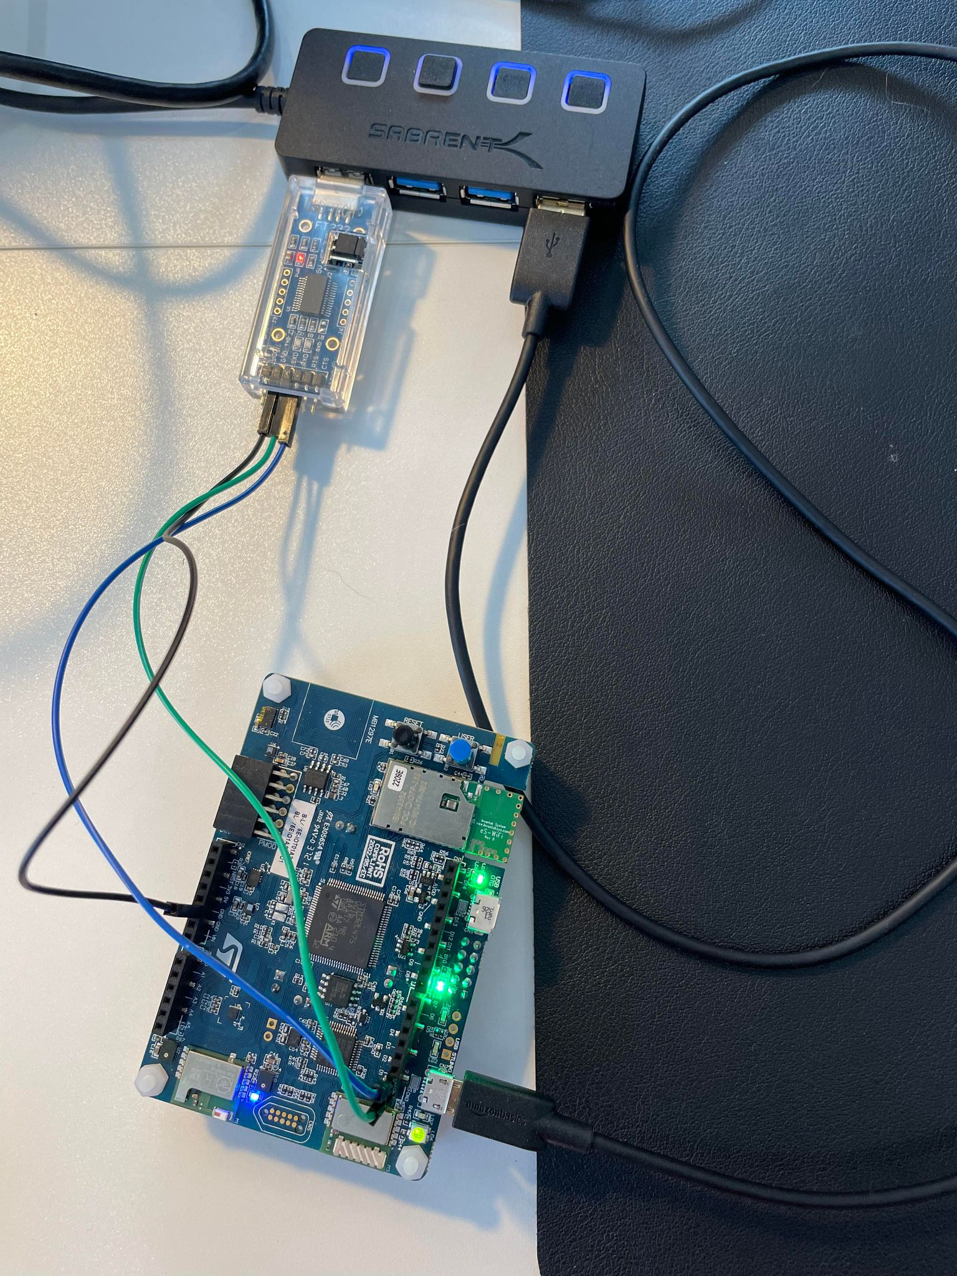
Appendix. I use USB to UART converter and connect UART4 Rx and Tx to it

